Slide 1
Lecture 3
Process Model
Engr. Rahemeen Khan
Sr. Lecturer
Software Engineering Department

Slide 2
Objective
Waterfall Model
V-Model
Incremental Model
Prototyping Model
Spiral Model
Other Process Models
Summary

Slide 3
Software process models
The waterfall model
Plan-driven model. Separate and distinct phases of specification and development.
Incremental development
Specification, development and validation are
interleaved. May be plan-driven or agile.
Reuse-oriented software engineering
The system is assembled from existing components. May be plan-driven or agile.
In practice, most large systems are developed using a process that incorporates elements from all of these models.

Slide 4
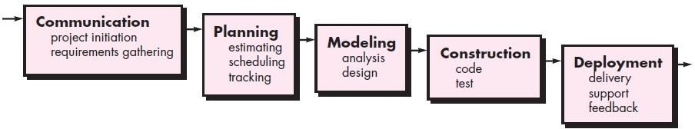
The Waterfall Model
26

Slide 5
Waterfall model characteristics
The classic life cycle - oldest and most widely used paradigm
In “The Waterfall” approach, the whole process of software development is divided into separate phases.
The outcome of one phase acts as the input for the next phase sequentially. This means that any phase in the development process begins only if the previous phase is complete.
If there are corrections, return to a previous phase and ‘flow’ from there again
27

Slide 6
Advantages of the Waterfall Model
Classical Waterfall Model is very simple and easy to understand.
Phases in the Classical Waterfall model are processed one at a time.
In the classical waterfall model, each stage in the model is clearly defined.
Classical Waterfall model has very clear and well-understood milestones.
Processes, actions, and results are very well documented.
Classical Waterfall Model reinforces good habits like define-before-design and design-before-code.
Classical Waterfall Model works well for smaller projects and projects where requirements are well understood.

Slide 7
Disadvantages of Waterfall Model
In this model, the risk factor is higher, so this model is not suitable for more significant and complex projects.
This model cannot accept the changes in requirements during development.
It becomes tough to go back to the phase. For example, if the application has now shifted to the coding phase, and there is a change in requirement, It becomes tough to go back and change it.
Since the testing done at a later stage, it does not allow identifying the challenges and risks in the earlier phase, so the risk reduction strategy is difficult to prepare.
28

Slide 8
V- MODEL
The V-model is an SDLC model where execution of processes happens in a sequential manner in a V-shape. It is also known as Verification and Validation model.
The V-Model is an extension of the waterfall model and is based on the association of a testing phase for each corresponding development stage.
Verification: It involves a static analysis method (review) done without executing code.
Validation: It involves dynamic analysis method (functional, non-functional), testing is done by executing code.

Slide 9
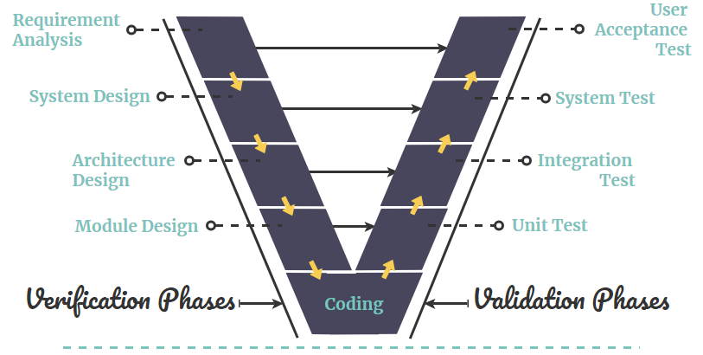
V- MODEL

Slide 10
Advantages of the V-MODEL
Easy to Understand.
Testing Methods like planning, test designing happens well before coding.
This saves a lot of time. Hence a higher chance of success over the waterfall model.
Works well for small plans where requirements are easily understood.
Proactive defect tracking.

Slide 11
Drawbacks of the V-MODEL
Very rigid and least flexible.
Not a good model for complex and object-oriented projects.
Poor model for long and ongoing projects.
Not suitable for the projects where requirements are at a moderate to high risk of changing.
Once an application is in the testing stage, it is difficult to go back and change a functionality.

Slide 12
Incremental Model
The Incremental Model is a method of software development where the product is designed, implemented and tested incrementally.
The product is decomposed into a number of components, each of which is designed and built separately.
Multiple development cycles take place here, making the life cycle a “multi-waterfall” cycle.
Cycles are divided up into smaller, more easily managed modules.

Slide 13
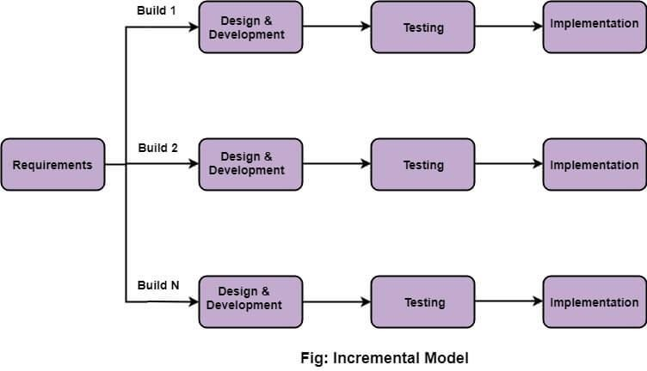
The Incremental Model

Slide 14
Incremental development benefits
Incremental Model allows partial utilization of the product and avoids a long development time.
Generates working software quickly and early during the software life cycle.
This model is more flexible and less costly to change scope and requirements.
It is easier to test and debug as smaller changes are made during each iteration.
In this model, the customer can respond to each built.
32

Slide 15
Incremental development problems
As additional functional is added to the product at every stage, problems may arise related to system architecture which was not evident in earlier stages.
It needs good planning and design at every step.
Needs a clear and complete definition of the whole system before it can be broken down and built incrementally.
Total cost is higher than waterfall.

Slide 16
Problems with Requirements
The first step in the waterfall is requirements gathering and analysis
In practice, this is the most difficult part and experience with the waterfall – indicates that most failures are due to inadequate requirements understanding
Users often change requirements as they see what CAN be done

Slide 17
The Prototyping Model
A software prototype is a preliminary or first built working model of the desired product.
It represents and resembles the original, desired product, in terms of basic or limited features or functionalities, but lacks the completeness.
This operational dummy, gives an overview of the final product, which is to be developed.
It is one of the forms of the Software Development Cycle (SDLC) models, which is based on the quick initial development of the prototypes based on the currently available or limited requirements.
This enables the developers, to understand the further requirements that need to be implemented in the software product, through receiving feedbacks, in respect of delivered prototype, from the client.

Slide 18
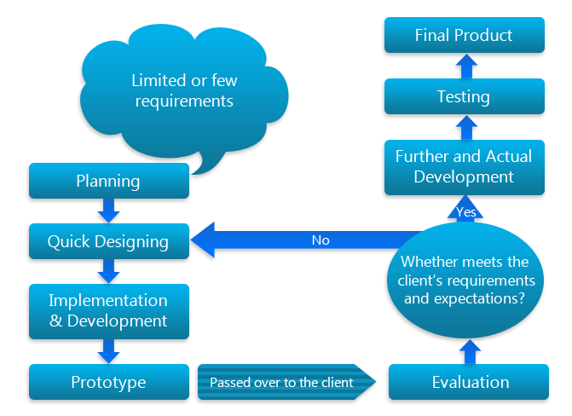
The Prototype Model

Slide 19
The Prototype Model
(1) Requirements Gathering and Analysis
Much like waterfall model, but less rigorous since prototype will help expose shortages
Quality control – requirements reviews (inspection)
(2) Quick Design
Make a simple approximate initial design, refine during prototype iteration
Quality control – prototype testing
(3) Build Prototype
Quickly hack together an approximate implementation showing relevant external features
Quality control – essentially none

Slide 20
The Prototype Model
(4) Customer Evaluation
Users validate prototype, report shortages
Quality control – acceptance testing and evaluation (inspection)
(5) Design Refinement
Refine design in response to user feedback from prototype
Quality control – design reviews (inspection)
(6) Full Scale Development
Remaining stages of traditional waterfall model

Slide 21
Advantages of the prototyping model
▷ Customers get a say in the product early on, increasing customer satisfaction.
▷ Missing functionality and errors are detected easily.
▷ Prototypes can be reused in future, more complicated projects.
▷ It emphasizes team communication and flexible design practices.
▷ Users have a better understanding of how the product works.
▷ Quicker customer feedback provides a better idea of customer needs.

Slide 22
Drawbacks of the Prototyping Model
Practically, this methodology may increase the complexity of the system as scope of the system may expand beyond original plans
it is more costly in terms of time and money when compared to alternative development methods, such as the spiral or waterfall model.

Slide 23
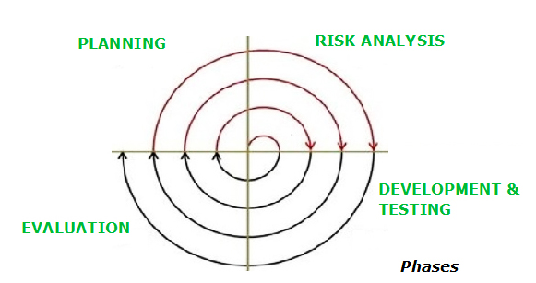
The Spiral Model
The spiral model is similar to the incremental model, with more emphasis placed on risk analysis.
The spiral model has four phases: Planning, Risk Analysis, Development & Testing and Evaluation
A software project repeatedly passes through these phases in iterations (called Spirals in this model).

Slide 24
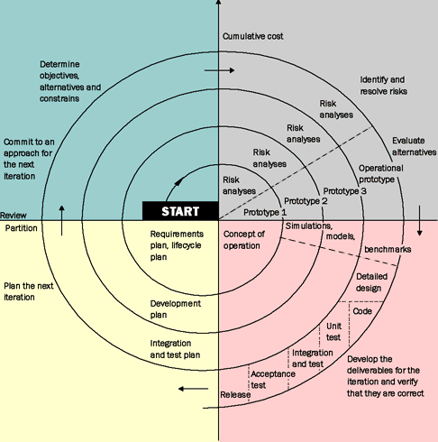
OBJECTIVES
Determine objective alternative, constraints
RISKS
Evaluate alternative, identify & resolve risks
DEVELOP
Develop & Verify next level product
PLAN
Review Status & Plan Next Phase

Slide 25
Why Spiral Model is called Meta Model?
The Spiral model is called a Meta-Model because it subsumes all the other SDLC models. For example, a single loop spiral actually represents the Iterative Waterfall Model.
The spiral model incorporates the stepwise approach of the Classical Waterfall Model.
The spiral model uses the approach of the Prototyping Model by building a prototype at the start of each phase as a risk-handling technique.
Also, the spiral model can be considered as supporting the Evolutionary model – the iterations along the spiral can be considered as evolutionary levels through which the complete system is built.

Slide 26
The Spiral Model
Four Step Cycle
In each layer, the same four step cycle is used, consisting of:
Determine Objectives
determine objectives, constraints, risks for next phase
Assess and Reduce Risks
analyze and reduce identified risks
Develop and Validate
choose development model, develop and test
Review and Plan
review status, plan next layer

Slide 27
Advantages of Spiral model
▷ High amount of risk analysis hence, avoidance of Risk is enhanced.
▷ Good for large and mission-critical projects.
▷ Strong approval and documentation control.

Slide 28
Drawbacks of the Spiral Model
Can be a costly model to use.
Risk analysis requires highly specific expertise.
Project’s success is highly dependent on the risk analysis phase.
Doesn’t work well for smaller projects.

Slide 29
Still Other Process Models
Component Assembly —the process to apply when reuse is a development objective
Unified Process—a “use-case driven, architecture-centric, iterative and incremental” software process closely aligned with the Unified Modeling Language (UML)
48

Slide 30
Component Assembly Model
▷ Instead of starting over with different codes and languages, developers who use this model tap on the available components and put them together to build a program
model, constantly creating a prototype until a software that will cater the need of businesses and consumers is realized.
▷ | Component | Assembly | Model | is | an | iterative
 | development | model. It | works | like | the | Prototype

Slide 31
Component Assembly Model
Extract components
es
y
Identify candidate components
Look up components in library
Construct System
Available?
no
Build components

Slide 32
Unified Process
This process divides the development process into four phases:
Inception
Elaboration
Conception
Transition

Slide 33
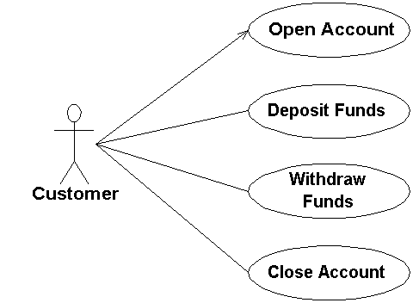
Unified Process
UP has the following major characteristics:
It is use-case driven
It is architecture-centric
It is risk focused
It is iterative and incremental

Slide 34
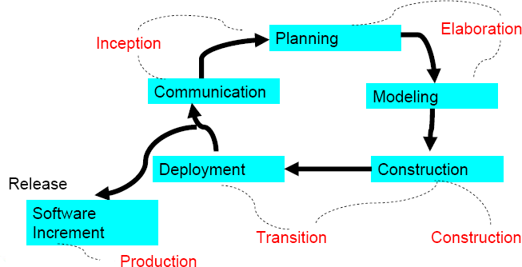
The Unified Process (UP)
53

Slide 35


UP Phases
UP Phases
Inception
Elaboration
Construction
Transition
Production
Workflows
Requirements
Analysis
Design
Implementation
Test Support
Iterations
#1
#2
#n-1 #n
54

Slide 36
Inception Phase
▷ During the inception phase, the basic idea and structure of the project is determined. The team will sit down and determine if the project is worth pursuing at all, based on the proposed purpose of the project, the estimated costs (monetary and time), and what resources will be required to complete the project once the green light is given

Slide 37
Elaboration Phase
▷ The purpose of the elaboration phase is to analyze the requirements and necessary architecture of the system.
▷ The success of this phase is particularly critical, as the final milestone of this phase signifies the transition of the project from low-risk to high- risk, since the actual development and coding will take place in the following phase.

Slide 38
Construction Phase
▷ the construction phase is when the coding and implementation of all application features will take place. This period is also where integrations with other services or existing software should occur.

Slide 39
Transition Phase
The transition phase is when the finished product is finally released and delivered to customers. However, the transition phase is more than just the process of deployment; it must also handle all post-release support, bug fixes, patches, and so forth.

Slide 40
Summary
Software Process defines the methodology to construct a software.
Essential software process phases are Analysis, Design, code and maintenance.
Software model describes the way how a software can be reused.
Any model or the combination of models can be used as according to the nature of software.

Slide 41
Q/A

